Slide 1
FSIC 605: GENERAL FORENSIC SCIENCE
Questioned Document Analysis by Document Examiners

Slide 2
LEARNING OBJECTIVES
To understand the Questioned Document Analysis by Document Examiners.

Slide 3
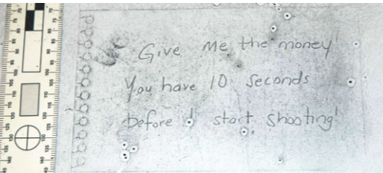
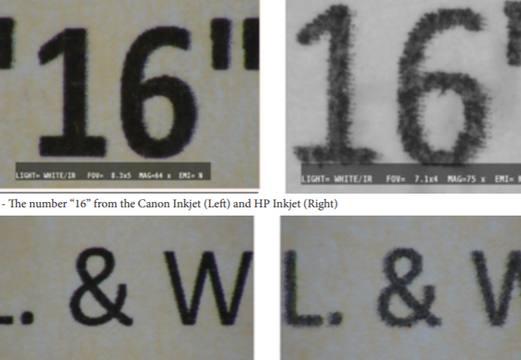
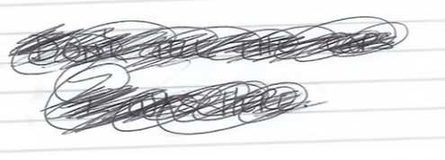
Questioned Document Analysis by Document Examiners
Signature & Handwriting Examination
Examination of Printers, Fax Machines, Typewriters and Photocopy Machines
Ink Examination
Notes:
Document examiners use scientific principles of handwriting and ink analysis for examining the different types of questioned documents. Questioned Document Analysis by document examiners includes handwriting examination and the analysis of several other features of the questioned document.
Signature & Handwriting Examination
Handwriting and signature are unique to a particular individual. This makes it possible for document examiners to identify forgery or alterations. Document examiners trained in handwriting and signature analysis are thus able to identify a forged handwriting/signature from a genuine one.
Examination of Printers, Fax Machines, Typewriters and Photocopy Machines
In the case of typewritten questioned documents, Document Examiners go to the extent of examining the very machines that produced them. For instance, a typewriter output always has certain exclusive properties. Some of these properties are the same for a particular model of the machine – electric/manual, carbon film ribbon/fabric ribbon etc. Typewriters, printing or photocopy machines also produce unique properties on its output depending on its abuse, damage, wear and tear.
Ink Examination
Document examiners sometimes use liquid chromatography to extract samples of ink from a questioned document for analysis. Other methods of ink examination include subjecting the questioned document to infrared radiation. This helps identify forged documents because different inks react differently when exposed to different frequencies of infrared light.

Slide 4
Questioned Document Analysis by Document Examiners
Detection of Indentation
Detection of Deletions, Erasures and Other Alterations
Notes:
Detection of Indentation
Documents recovered from a crime scene or a suspect may also give crucial leads from impression evidence or indented writing. Certain documents do not contain any distinguishing mark or note. However, when analyzed with an Electrostatic Detection Device (EDD), they reveal certain invisible impressions or indentations. These could help establish crucial links between a suspect and the crime.
Detection of Deletions, Erasures and Other Alterations
Forensic Document Examination can reveal for evidence of alterations, obliterations, erasures and page substitutions. Such changes that are not visible to the naked eye can be detected using photography and UV/IR imaging devices. Imaging instruments such as a Video Spectral Comparator (VSC) use radiations of different wavelengths to identify additions, erasures or alternations. This is possible by the different reactions of different inks to varied wavelengths of light.
The other examinations that are a part of Questioned Document Examination are:
• Surface features • Latent images • Alterations • Watermarks • Ink stamps • Embedded invisible information • Tampering and photo-substitution • Rubber stamps, cheque-writers, and label and price markers • Printing processes • Analysis of paper, ink and/or pencil used

Slide 5
LEARNING OUTCOMES
The Student will be able to understand the Questioned Document Analysis by Document Examiners.

